Slide 1


Hospitals & Diagnostic Centers
More than
5000+ Hospital
&
1800 Labs & Day Care Centres
Regions | No of hospitals
North | 1245
West | 1200
South | 2278
East | 280
Total | 5000 +
Raksha TPA
An ISO 9001-2008 Co

Slide 2
OUR PROCESSES
Raksha TPA
An ISO 9001-2008 Co
Raksha TPA
An ISO 9001-2008 Co
Raksha TPA
An ISO 9001-2008 Co
Raksha TPA
An ISO 9001-2008 Co

Slide 3
What Policy cover…
Sum Insured = Rs 100000/-
The scheme covers all pre-existing illness of the insured students.
Day one coverage for new students.
Day one coverage for new born
Pre & post hospitalization reimbursement is covered for 30 and 60 days respectively
There will be no age limit on the insured Student covered by this scheme
For the new students, who may join the Institute from time to time, identical coverage will to be made available from the day one of joining and the premium is paid.
No claim shall be lodged for bill less than Rs. 250/-.
List of chronic diseases covered as in-patient
Asthama
Arthiritis
Non-infectious disease
Respiratory disease
Chronic obstructive pulmonary disease
Rheumatoid Arthritis
Alzheimer disease.

Slide 4
The treatment related to all psychiatric & psychosomatic dis-order is covered upto Rs. 30,000/- as INDOOR PATIENT.
Vaccination for bites and stings such as dog bite, snake bite, insect bites are covered
Policy covers the treatment for Cancer.
Maternity expenses are covered upto Rs. 30,000/-, except abdominal operation for extra uterine pregnancy (Ectopic pregnancy ), which is proved by submission of ultra sonographic Report and Certification by Gynaecologist that it is life threatening.
Normal Room charges shall be 2% of the sum insured and in case of ICU
it would be 4% of the sum insured.
Diseases which are not specifically excluded in the policy exclusions or explicitly denied are covered.
Spouse of the member student is not covered.

Slide 5
Guide lines for cashless facility
If Insured/Patient going for Planned Treatment, So he/she can apply for cashless facility before 7 days from planned date of hospitalization.
Documents required from Patient
Submit copy of Photo ID proof along with copy of Raksha E-card to Hospital team & convey for application of cashless.
In case emergency hospitalization convey to hospital (TPA Desk) & submit photo ID Proof along with copy of Raksha E-card on earliest possible (within 24 hours).
In case of any query from TPA please arrange to provide the required detail/ documents to hospital team at TPA desk.
After discharge from the Hospital Sign the hospital bill leave original documents at hospital.

Slide 6

Cashless Process
Insured Approaches Network Hospital
with Raksha TPA ID Card
Hospital Intimates Raksha TPA and
sends Pre-Authorisation Request
Insured Bears
Non medical expenses Not Covered
Under Policy Conditions
Raksha TPA issues Authorisation Letter
As per Eligibility and Coverage
At The Time Of Discharge Insured to sign
all the original documents
- TAT for cashless extension – 0 -2 hours
- Intimation for planned admissions to be give 2 to 3 days in advance and for emergency admissions within 24 hours of such admissions
Raksha TPA
An ISO 9001-2008 Co
Notes:
6

Slide 7
Intimation Process
Online Web Intimation
Through E mail
By HRD Team
Employee may call our Call Centre
Intimation through Mobile Application
Online Claim Intimation Reference number is shared at all levels
Raksha TPA
An ISO 9001-2008 Co

Slide 8
Guide lines for Reimbursement of Claims
Submit the Claim intimation to TPA by email at lucknowraksha@rakshatpa.com or by call or your can registered your intimation at www.rakshatpa.com on intimation link.
Intimation should be given with in seven days of admission or before discharge, in case of plan treatment you can give the intimation before seven days of hospitalization.
Collect complete original claim papers (Hospital Bill, Receipt against payment of Hospital bill, investigation reports, in case of Fracture Pre & Post procedure x-ray film, itemized break up of hospital bill) from hospital.
Fill enclosed claim form
Submit all original Claim papers along with duly filled & signed claim form within 15 days from Date of Discharge (kindly keep the photocopy of all submitted papers with you for further reply or treatment).
If patient taking treatment at our Network/Panel hospital so opt for the cashless.

Slide 9
Documents Check List for Claim submission
Claim Form duly filled up & signed by the insured.
Raksha Member ID Card No/ Employee S.R.No.
Copy of Photo & address ID Proof.
Original Discharge Summary.
In case of Day Care treatment as Dialysis/chemo/radiotherapy provide day Care Summary duly mentioned date of above procedure.
Original Death summary (issued by the Hospital) in case of death claim.
Copy of Death Certificate (issued by Corporation/Nagar Nigam).
Original Pre printed numbered Hospital bill.
Original Pre printed numbered payment receipt against hospital bill.
Original Pharmacy bill with batch nos. with supportive doctor’s prescriptions.
Original Investigation bills/cash receipt with reports & supportive doctor’s prescriptions.
Copy of Hospital case sheet in case prolong hospitalization and claims worth Rs 1 lakh & above.
Police FIR/Medicolegal certificate where applicable or in case Road Traffic Accident.
Pre & post procedure x-ray film in case of fracture.
Sticker of implant in case of implant used.

Slide 10

Re-imbursement Process
Insured Gets Hospitalised In Non-network Hospital
and intimates Raksha as per policy terms
Claim Folder Is Sent To Raksha TPA
within the stipulated period
Claim is Processed
If Documents Are Insufficient
Intimation sent To Employee/HR/Broker
Claim Passed / Rejected
Maximum TAT for settlement
Subject To Availability Of All Necessary
Documents Will Be within 7 Working Days
Raksha TPA
An ISO 9001-2008 Co
Notes:
10

Slide 11
Escalation Matrix
First Level:
Mr Shailendra Srivastav
Mobile 8382991757
shailendra.kumar0089@gmail.com
Mr Satish Kumar
Mobile 9958600698 ,
Email : satishsingh2490@gmail.com
Second Level:
Mr Vinay Kumar Asthana
Mobile 9415130435
Email: vinayasthana2003@gmail.com
Third Level:
Mr Abhinandan Dubey
Mobile 9451802802
Abhinandan@rakshatpa.com
In case of non-response of above levels please write to Mr Vivek Pandit on Vivek@rakshatpa.com
Office contact no. 9am to 6 pm - 8090046594,8090046595 and toll free no. 24X7 1800-180-1444
Call us on Emergency, Communicate on SMS & E-mail

Slide 12
MOBILE APP

Slide 13

MOBILE APPS
Supporting Platforms to download Raksha TPA Mobile App
• Android
• IOS
• Windows
• Blackberry
Raksha TPA
An ISO 9001-2008 Co
Raksha TPA
An ISO 9001-2008 Co
Raksha TPA
An ISO 9001-2008 Co
Raksha TPA
An ISO 9001-2008 Co
Notes:
13

Slide 14
RAKSHA MOBILE APP
Benefits:
Real time Update of Cashless and Claims
Easy download of Ecards
Address are mapped through GPS for locations
Claim Intimations
Raksha TPA
An ISO 9001-2008 Co
Raksha TPA
An ISO 9001-2008 Co
Raksha TPA
An ISO 9001-2008 Co
Raksha TPA
An ISO 9001-2008 Co
Notes:
14

Slide 15
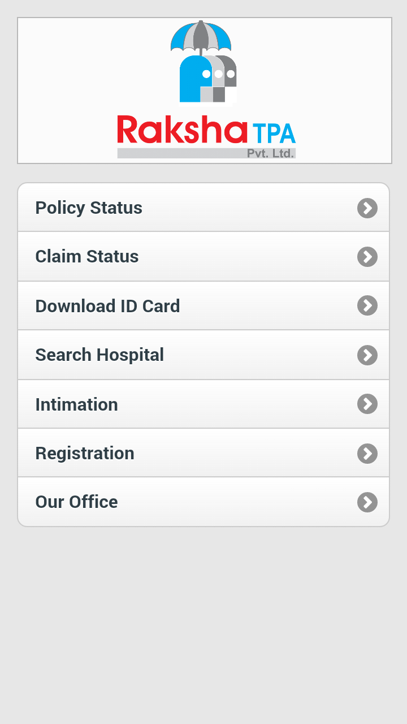
MOBILE APP
Raksha TPA
An ISO 9001-2008 Co
Raksha TPA
An ISO 9001-2008 Co
Raksha TPA
An ISO 9001-2008 Co
Raksha TPA
An ISO 9001-2008 Co

Slide 16
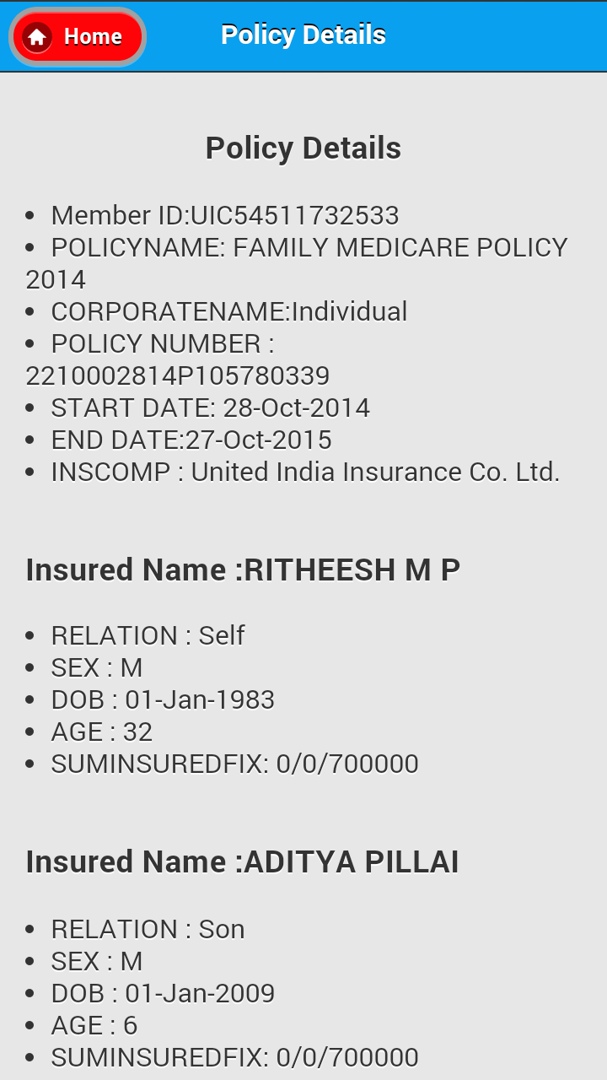

MOBILE APP
Raksha TPA
An ISO 9001-2008 Co
Raksha TPA
An ISO 9001-2008 Co
Raksha TPA
An ISO 9001-2008 Co
Raksha TPA
An ISO 9001-2008 Co

Slide 17
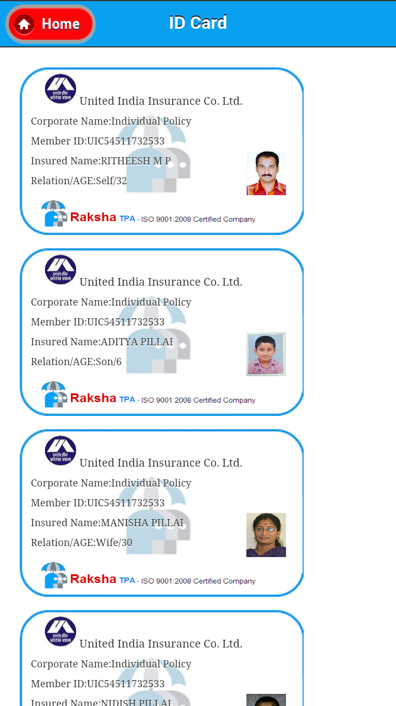
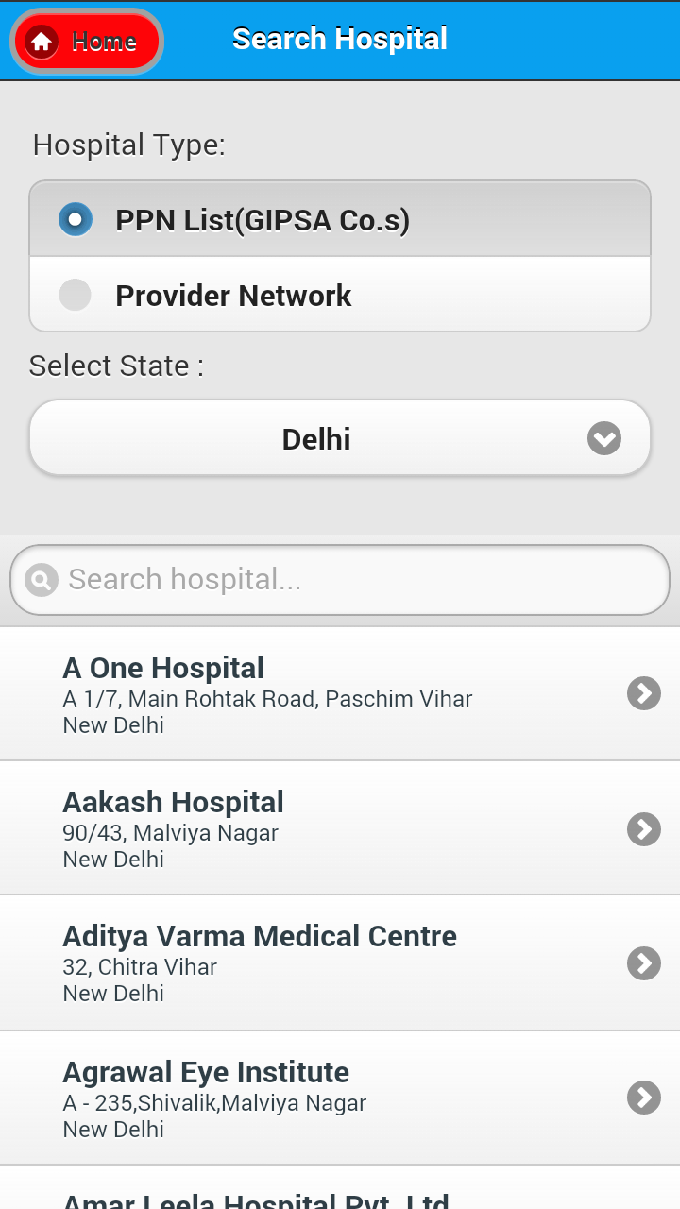
MOBILE APP
Raksha TPA
An ISO 9001-2008 Co
Raksha TPA
An ISO 9001-2008 Co
Raksha TPA
An ISO 9001-2008 Co
Raksha TPA
An ISO 9001-2008 Co

Slide 18
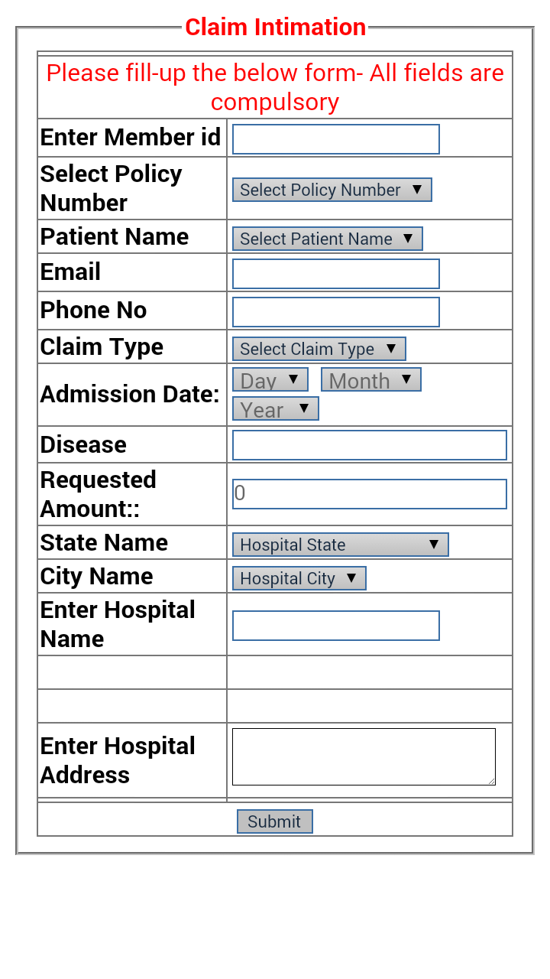
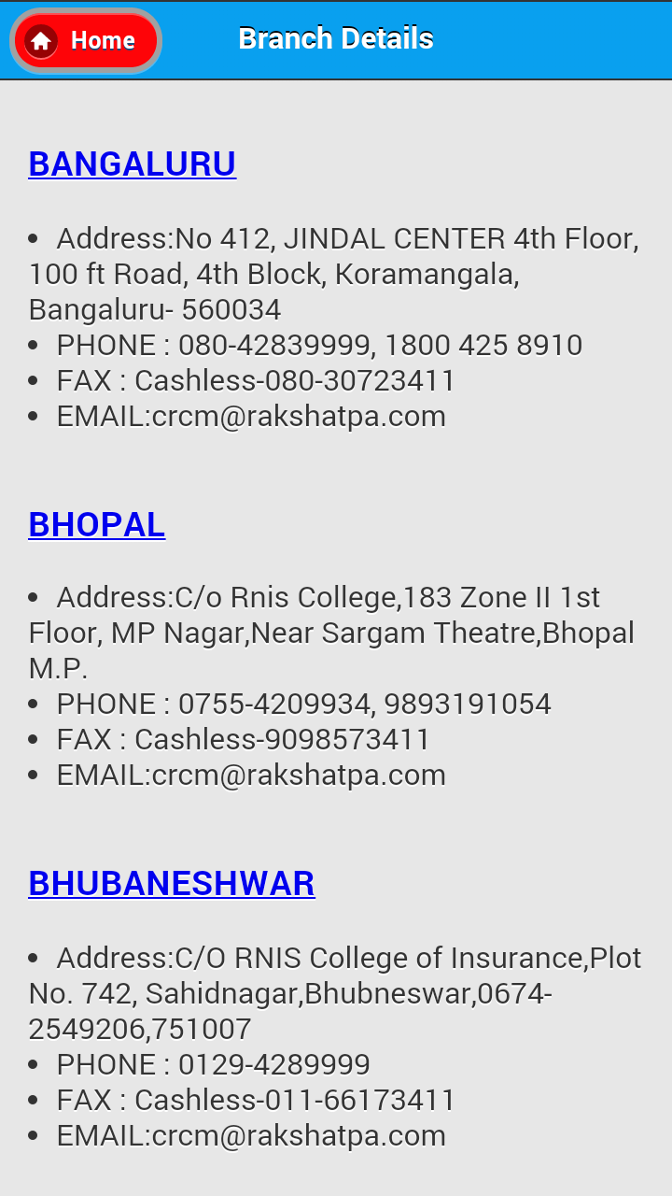
MOBILE APP
Raksha TPA
An ISO 9001-2008 Co
Raksha TPA
An ISO 9001-2008 Co
Raksha TPA
An ISO 9001-2008 Co
Raksha TPA
An ISO 9001-2008 Co

Slide 19


THANK YOU....
Raksha TPA
An ISO 9001-2008 Co
Notes:
19

